Slide 1
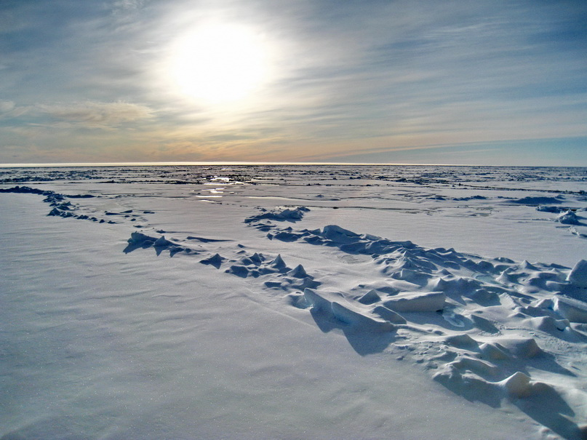
Construction of a Comprehensive Satellite Derived Dataset Over the Arctic
Matthew Christensen^{1,2}, Graeme Stephens¹, and Ryan Fullerr¹
Jet Propulsion Laboratory¹
Colorado State University²

Slide 2
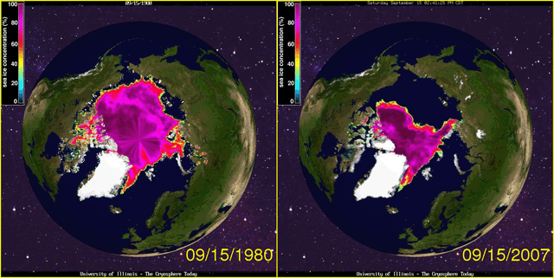
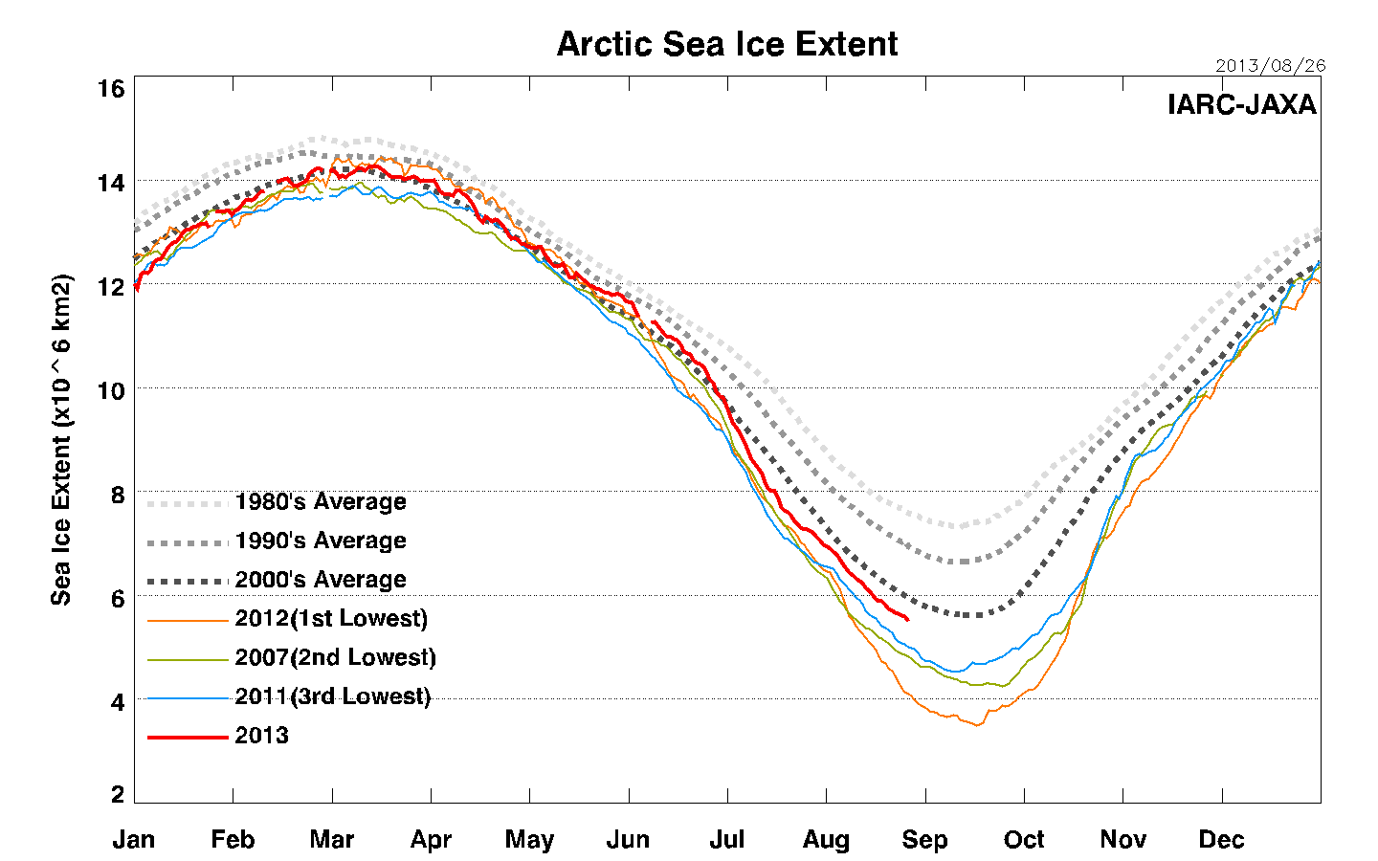
Arctic Melting
IPCC 4th Assessment report stated that it is very likely that the rise of CO2 and other greenhouse gases has led to the dramatic decline of sea ice and snow extent across the Arctic.
Sea ice extent has a substantial seasonal cycle with a minimum occurring in September.
Last September had the lowest sea ice extent on record.
National Snow and Ice Data Center (NSIDC) Sea Ice Extent Product
Notes:
The NSIDC Near-Real-Time DMSP SSM/I Daily Polar Gridded Sea Ice Concentrations and the Sea Ice Concentrations from Nimbus-7 SSMR and DMSP SSM/I Passive Microwave Data data sets are used to generate the monthly records of sea ice extent and sea ice concentration for the Arctic and Antarctica from satellite passive microwave data.
Arctic images: http://www.wunderground.com/blog/JeffMasters/arctic-sea-ice-loss-tied-to-unusual-jet-stream-patterns
Arctic sea ice extent: http://www.google.com/imgres?imgurl&imgrefurl=http%3A%2F%2Fwww.ijis.iarc.uaf.edu%2Fen%2Fhome%2Fseaice_extent.htm&h=0&w=0&sz=1&tbnid=iTloVOBGTCxMBM&tbnh=177&tbnw=284&prev=%2Fsearch%3Fq%3Darctic%2Bsea%2Bice%2Bextent%26tbm%3Disch%26tbo%3Du&zoom=1&q=arctic%20sea%20ice%20extent&docid=SH6e1AK75n0zbM&ei=XEkeUrL7IaqaigKZrYD4DA&ved=0CAEQsCU

Slide 3
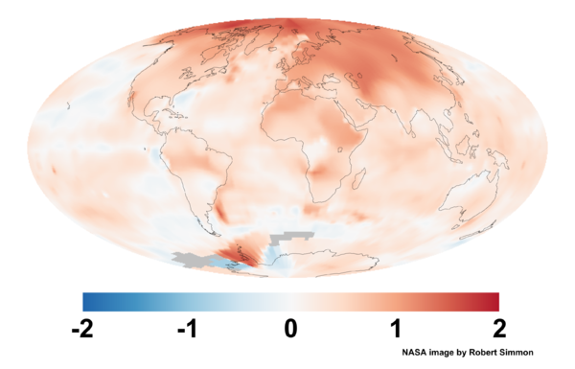
Arctic Amplification
2000 – 2009 GISS Surface Temperature Anomaly
Ice-albedo feedback: Bright snow and sea ice melt giving way to darker ocean which absorb more solar radiation causing greater heating.
Less snow and ice
Warmer
temperatures
Greater temperature increases in the Arctic compared to the earth as a whole.
More sunlight absorbed by land and sea
Notes:
Manabe and Stouffer (1980) first popularized the phrase “polar amplification”
S.H. Hemisphere does not warm because the presence of the deep and circulating ocean component uptakes the heat as the climate warms.
Host of other reasons this could happen as well: global feedbacks, moisture transport, ect…

Slide 4
The ice-albedo feedback has a competitor: clouds
Less snow and ice
Warmer
temperatures
Negative feedback
More sunlight absorbed by land and sea
reduces the effect
More clouds
Source: Kato et al. 2006, GRL
Increased evaporation
Cloud fraction in Arctic on summer days is about 80%.
MODIS Cloud coverage increased between 2000 and 2004.
Increase in clouds cancel out the impact of melting snow and ice on polar albedo.

Slide 5
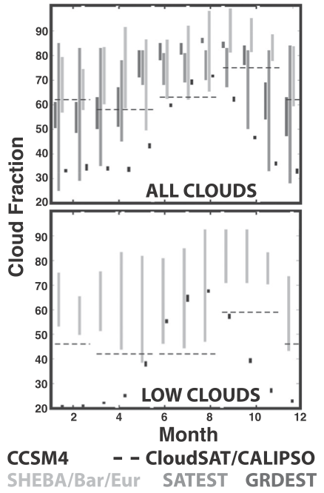
Simulations of Clouds in GCM
70 – 90 N
Bennartz et al. (2012) demonstrate using surface-based observations, remote sensing data, and a surface energy-balance model that extensive melting on the greenland ice sheet was due to enhanced downward longwave emission by thin low-level liquid clouds.
These low-level liquid clouds are important but treated poorly in GCMs and may explain the difficult history that global models have had in simulating the Arctic surface energy budget.
The CCSM4 ensemble underestimates total cloud cover for much of the year compared to satellite and ground-based observations.
CCSM4 bias is about -11 W/m^2 during summer months compared to CERES.
Source: De Boer et al (2012), JCLIM

Slide 6
Other Important Processes
Faster melting of snow and ice may be due to changes in the troposphere circulation that affect clouds and radiation over the arctic.
Transport of more soot particles into the arctic can lead to faster melting of snow and ice (Hansen et al. 2000).
Lack of sea ice may affect the circulation and weather patterns. Liu et al. 2012, PNAS demonstrate that the loss of sea ice enhances the meandering of the polar jet thereby producing stronger cold surges and snowfall over parts of Europe and North America. Such incidences were observed in years with low sea ice extent.
Notes:
http://www.pnas.org/content/early/2012/02/17/1114910109.abstract

Slide 7
Goals
Develop a user friendly comprehensive satellite derived dataset to study multiple, and often complex, processes and interactions over the arctic region.
Most of the assimilated products have been published in peer-review journals.
Provide multiple measurements of the same variable using a variety of satellites and products.
e.g., cloud phase from MODIS, CALIPSO, AIRS, ect…
Enable efficient comparison amongst different products by storing data using a common format (NETCDF), grid, and classification approach.
e.g., data files classified by the cloud properties, radiation, surface properties, aerosol, and meteorology.
Evaluate Arctic cloud processes and feedbacks in multi-model GCM ensembles.

Slide 8
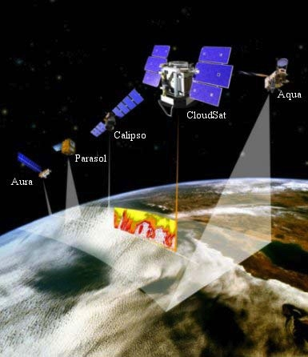
A-TRAIN Data Products
Aqua (May 2002)
MODIS
36 channels throughout the visible and infrared spectrum.
1 km pixels over a 2330 km wide swath
Aerosol and cloud properties.
AIRS
2378 spectral channels throughout the infrared
13.5 km horizontal resolution
Vertical profiles of temperature & moisture.
CERES
Broad band shortwave and longwave fluxes
20 km horizontal resolution
CloudSat (April 2006)
94 GHz Cloud profiling radar (CPR)
250 m vertical resolution
1.1 km horizontal resolution
Cloud liquid & ice profile, precipitation rates, radiative fluxes.
CALIPSO (April 2006)
Dual polarization lidar (532 & 1064 nm)
30 m vertical resolution
333 m horizontal resolution
Cloud frequency, height, phase.

Slide 9
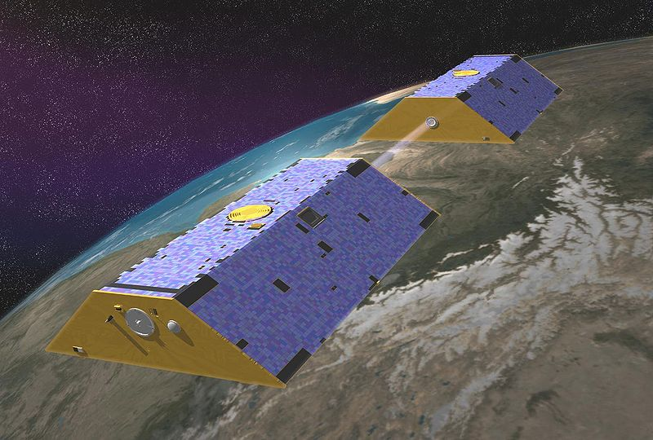
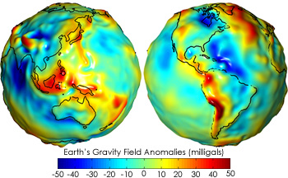
Data Products
Gravity Recovery And Climate Experiment (GRACE)
Launched: March 2002 into polar orbit.
Measures changes in the speed and distance between the two identical spacecraft using a microwave ranging system to an accuracy within 10 μm.
Gravitational anomalies are inferred by the placement of the twin satellites.
Equivalent water thickness is the observed monthly change in gravity caused by changes in the mass/thickness of water and corrected by fluctuations of the mass of the atmosphere.
220 km
Notes:
Improved the understanding of global ocean circulation via hills and valleys. Sea level rise, whether it is thermal expansion or melting. Hydrologic cyhcle, ect…

Slide 10
Re-analysis Derived Data Products
Monitoring Atmospheric Composition and Climate (MACC) – a GEMS follow on project
MACC re-analysis data assimilates total AOD from MODIS satellite observations into the ECMWF-AUX aerosol transport model.
1.25 x 1.25 degree 8 times daily
Aerosol optical depth
550 nm & 865 nm
Aerosol Species
Black carbon, dust, organic carbon, sea salt, & sulfate
NCEP re-analysis
Thermodynamic Profile
2.5 x 2.5 degree monthly averaged
Temperature, Humidity, Pressure, Geopotential Height, zonal, meridional, vertical wind
Surface Properties
Evaporation, Precipitation, Runoff, Latent Heat Flux, Sensible Heat Flux, Ground Heat Flux, Sea Level pressure.

Slide 11
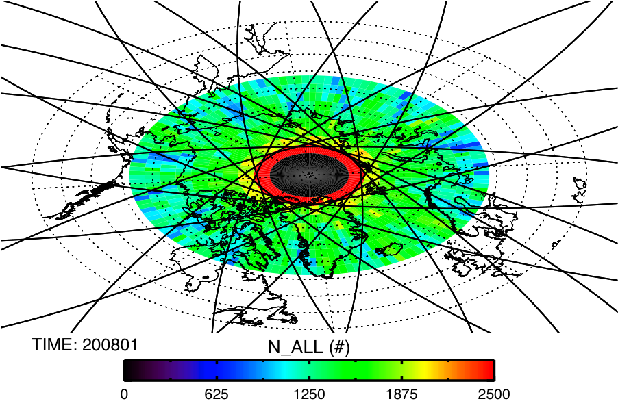
Geolocation
CloudSat Profiles
January 2008
Orbit: CloudSat is in a sun synchronous orbit with latitude range 82degS/N. Consecutive swaths are 2752 km apart at the equator. Return cycle is every 16 days. Makes 14 – 15 orbits per day.
Temporal Resolution: Monthly average data
Spatial Resolution: 2.5 x 2.5 degree regions
Range: 60 N to 90 N
Each region contains a minimum of 700 CloudSat profiles.
Boxes at higher latitudes are smaller but get more satellite passes per area.

Slide 12
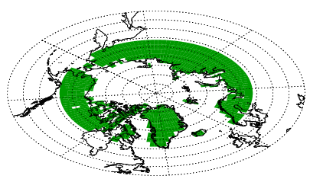
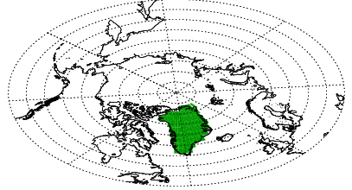
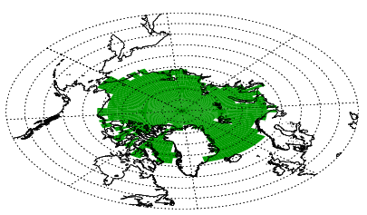
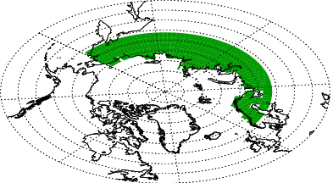
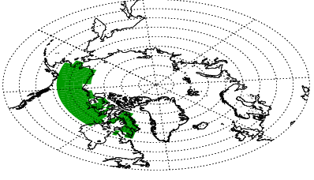
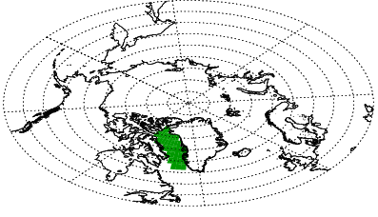
Region Mask Data
Land Mask
Greenland
Arctic Ocean
Eurasia
North America
Baffin Bay

Slide 13
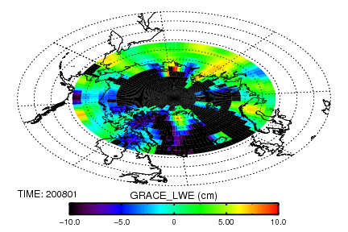
Surface Properties Total Water Storage Anomaly (GRACE)
Greenland
Product: CSR.LAND University of Texas
1°x1° averaged monthly
Total water storage can only be inferred over land.
Total water storage decreases over Greenland during the CloudSat period.
Greenland

Slide 14
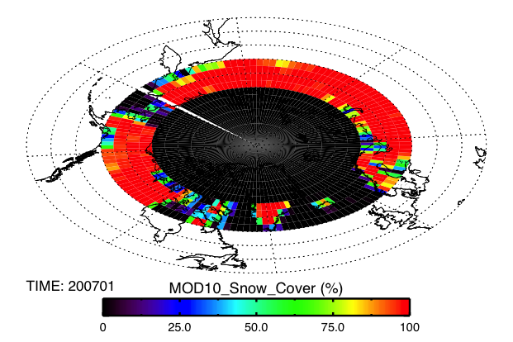
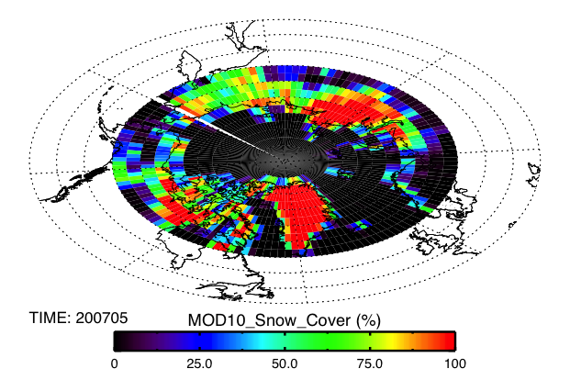
Surface Properties Snow Cover (MODIS)
Eurasia
Product: MOD10CM
0.05°x0.05° averaged monthly
Relies on solar reflection, near-IR radiances, and the MODIS cloud mask to determine snow coverage.
Snow cover has a clear seasonal cycle but no long term trend over Eurasia.
Going to include microwave measurements used in the sea ice and snow extent weekly product version 4 produced by the NSID.

Slide 15
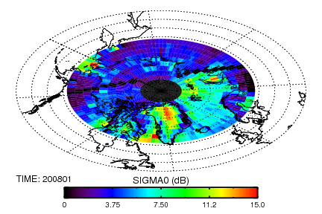
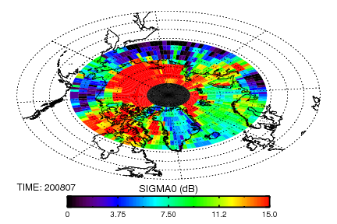
Surface Properties CloudSat: 94-GHz Surface Backscatter Cross Section (σ_{o})
January
Arctic Ocean
July
2B-Geoprof
Clear seasonal cycle in the surface reflectance.
Pools of liquid water on/near sea ice enhance the backscattering cross section of the surface.
Durden et al. (2011), IEEE Geoscience and Remote Sensing Letters describe how this data can be used to infer snow & vegetation changes over land, ect…

Slide 16
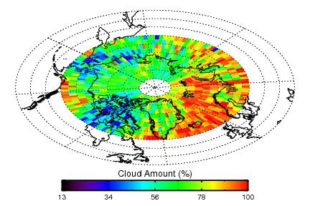
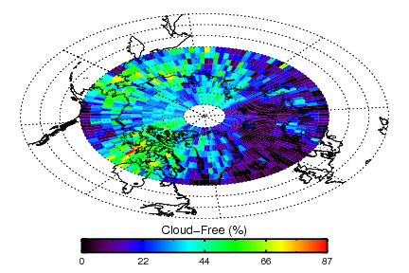
Cloud Cover Fraction
January 2008
2B-Geoprof-Lidar merges cloud layer detection from CloudSat and CALIPSO to produce the most accurate quantitative description of hydrometeor layers in the atmosphere that is possible.

Slide 17
Vertical Cloud Fraction 2B-Geoprof-Lidar
Greenland
125 vertical levels at 240 m resolution.
Clouds are included if they span the depth of the vertical bin.
Cloud fraction was greatest in 2006. Largest variability occurs at 4 km.
August Average
large annual variability
125 bins
*Count number of clouds that fall into each vertical bin to obtain vertical cloud fraction.

Slide 18
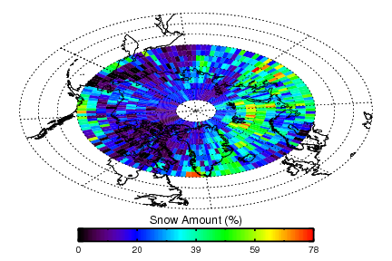
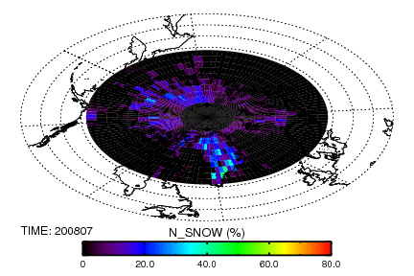
Precipitation
2008
January
Arctic Ocean
Total Cloud
Precip
Snow
Rain
July
2C-Precip-Column uses a reflectivity threshold of -15 dBZe and surface temperature from ECMWF re-analysis data to determine whether precipitation occurs in the solid or liquid phase.
Cloud coverage is highest in summer and lowest in winter.
Most of the precipitation falls as snow.

Slide 19
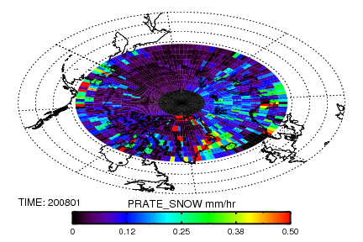
Surface Precipitation Rate Snowfall
Occurrence
January: 2008
Intensity
2C-SNOW-PROFILE estimates surface snowfall rates using an optimal estimation approach using reflectivity and estimated snow microphysical properties.

Slide 20
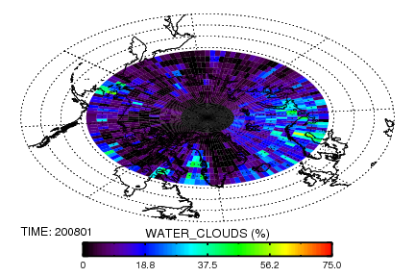
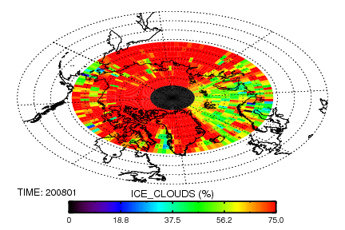
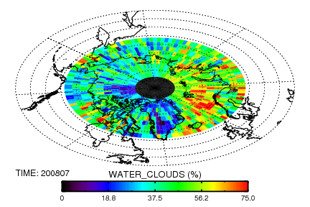
Cloud Phase CloudSat & CALIPSO
January: 2008
2B-CLOUD-CLASS-LIDAR:
Combines the CPR and LIDAR data to determine cloud phase.
Clear seasonal cycle in the fraction of water containing clouds.
Ice, water, mixed, unknown
Greenland exhibits significant increase in liquid clouds during summer.
July: 2008

Slide 21
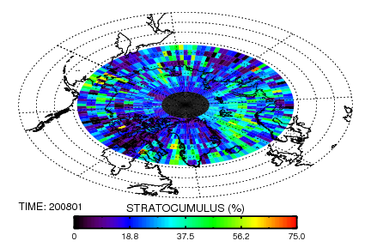
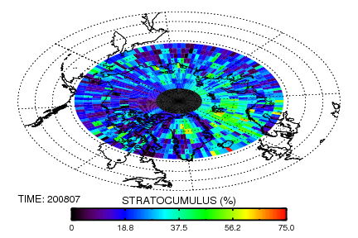
Cloud Type
January: 2008
Arctic Ocean
low-cloud
High-cloud
2B-CLOUD-CLASS-LIDAR:
Combines the CPR and LIDAR data to determine cloud type.
Max low cloud occurs in late spring. High cloud max is bi-modal in summer and winter!
High-over low cloud is very common
No clear cycle, need to examine some more.
Cirrus, Altostratus, Altocumulus, Stratus, Stratocumulus, Cumulus, Nimbostratus Cloud, Deep Convection
July: 2008

Slide 22
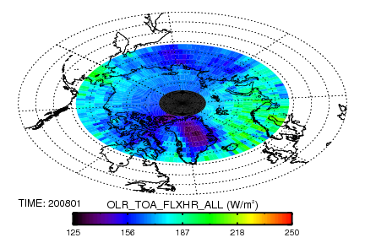
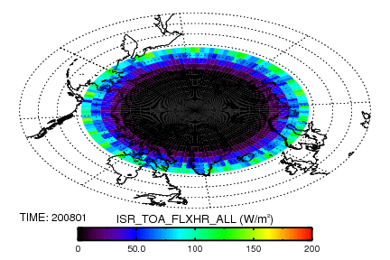
Top of atmosphere radiative fluxes Instantaneous Monthly Average
ALL-SKY Outgoing LongWave
CLEAR-SKY Outgoing LongWave
January 2008
Incoming ShortWave
2B-FLXHR-LIDAR ingests cloud and aerosol information from CloudSat and CALIPSO and atmospheric state variables from ECMWF reanalysis into a broadband, two-stream, plan-parallel doubling-adding radiative transfer model (AKA, BUGSRAD).
Radiative fluxes are composited by:
All-sky, clear-sky, non-precipitating clouds, precipitating clouds, snowing, & raining.

Slide 23
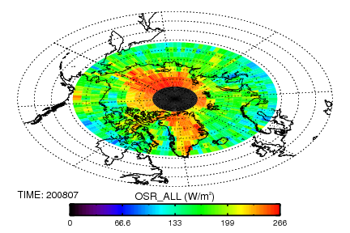
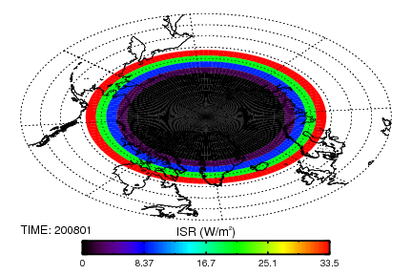
TOA: 3B-FLXHR-LIDAR Data provided and developed by Tristan L’Ecuyer
January
All-sky OLR
July
All-sky OLR
Incoming SW
3B-FLXHR-LIDAR is a level 3 product which includes a varying solar zenith angle that effectively samples the entire diurnal cycle.
Top atmosphere fluxes are provided for: All-sky and clear-sky conditions.
Going to add CERES EBAF-Surface product
January

Slide 24
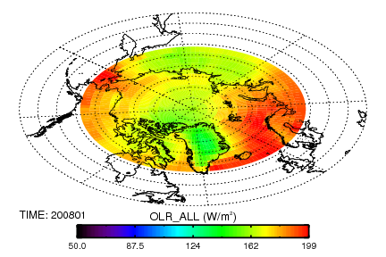
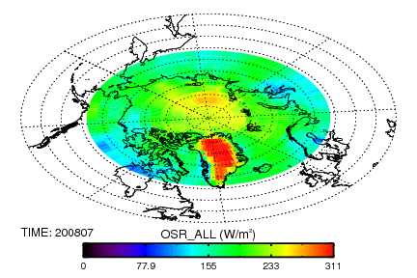
CERES (wide swath – not collocated to CloudSat)
January
July
CERES EBAF (Energy Balanced And Filled), edition 2.6 uses diurnally complete temporal averaging. Uses an objective constraintment algorithm to adjust SW and LW TOA fluxes within their raing of uncertainties to remove the inconsistency between average global net TOA flux and heat storage in the Earth-atmosphere system. Gaps in clear sky TOA flux are filled by using the MODIS measurements (1 km) in the larger footprint of CERES (20 km).
Top atmosphere fluxes are provided for: All-sky and clear-sky conditions.
Going to add CERES EBAF-Surface product

Slide 25
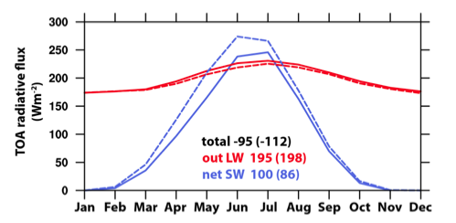
Comparison Between Products
CERES EBAF
Arctic
Two products have a high degree of agreement in the OLR (< 5 W/m^2). Outgoing shortwave is too small in the 3B-FLXHR-LIDAR product probably because the sea ice albedos used in the product are too low.
→ further investigation needed
3B-FLXHR-LIDAR
Dashed line is CERES, solid line is FLXHR-LIDAR

Slide 26
Clouds and Radiation over Greenland
Greenland land mask
Clear changes in cloud coverage over the seasonal cycle. Can also see longer term variability in cloud coverage.
Cloud changes do not have a distinct affect on the TOA radiation budget.
FLXHR-Lidar

Slide 27
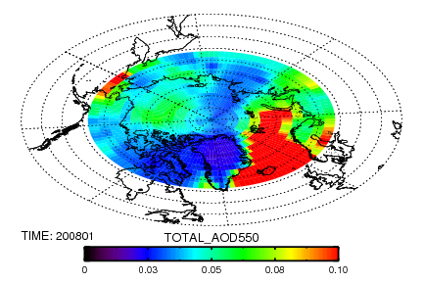
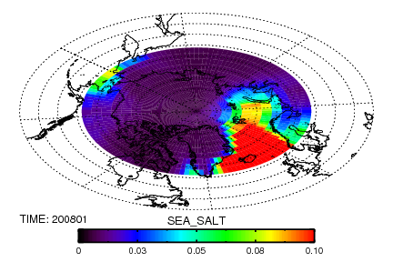
Aerosol Optical Depth Monitoring Atmospheric Composition and Climate (MACC) – a GEMS follow on project
Greenland
MACC Product Info:
MACC re-analysis data assimilates total AOD from satellite into the ECMWF-AUX aerosol transport model.
1.25 x 1.25 degree 8 times daily
550 nm & 865 nm
Black Carbon
Dust
Organic Carbon
Sea Salt
Sulphate

Slide 28
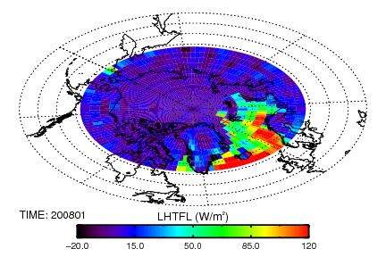
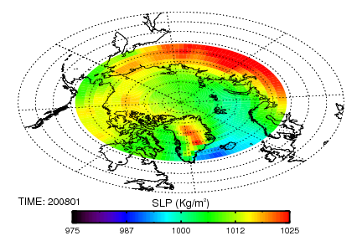
Meteorology NCEP re-analysis
Greenland
NCEP Product Info:
2.5° x 2.5° averaged monthly
Atmospheric Profile
Temperature
Specific Humidity
Geo Potential Height
Vertical Wind
Horizontal Wind
Surface
Evaporation, Sensible, Latent, & Ground Flux
Sea Level Pressure
Snow Depth
Ice Coverage
hPa

Slide 29
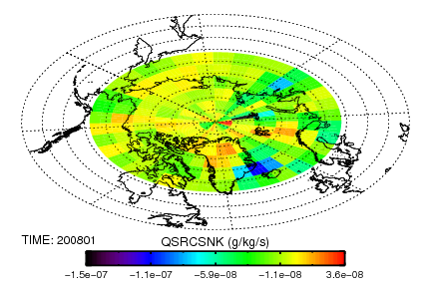
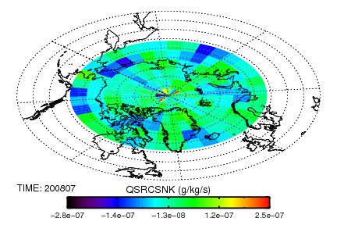
Moisture Divergence Sun Wong’s Product
Greenland
Product
Uses water vapor from AIRS level 3 gridded retrieval data and winds from MERRA.
Clear seasonal cycle in the moisture divergence over the Arctic region.
Strongest convergence of moisture occurs during summer months.
Other products include:
P-E, Horizontal and vertical water vapor flux, flux divergence, and water vapor tendency.

Slide 30
Future Work
Validate and compare results with published data.
Add cloud information from the standard MODIS product (e.g,. optical depth, effective radius, cloud top temperature, cloud phase).
Add cloud phase information from AIRS.
Add sea ice and snow data.
Add base of atmosphere radiative fluxes from CERES EBAF product.
Stage data online.
Any suggestions are welcome

